Slide 1

Shanghai Airbnb Analysis
Qiren Wang
qiren.wang@rutgers.edu

Slide 2
Data Source/ Dataset Description
Dataset Resources: http://insideairbnb.com/get-the-data.html
Shanghai Airbnb dataset collected the airbnb price in 2021.
Variables: price, name, host id, host name, Neighborhood-group, neighborhood, latitude, longitude, room-type, minimum-nights, number of reviews, last review, review per month, calculated host listings, and availability 365 days.
References：
[1] <https://rstudio.github.io/DT/> DT package instruction
[2] <https://cran.r-project.org/web/packages/hrbrthemes/hrbrthemes.pdf> hrbrthemes package instruction

Slide 3
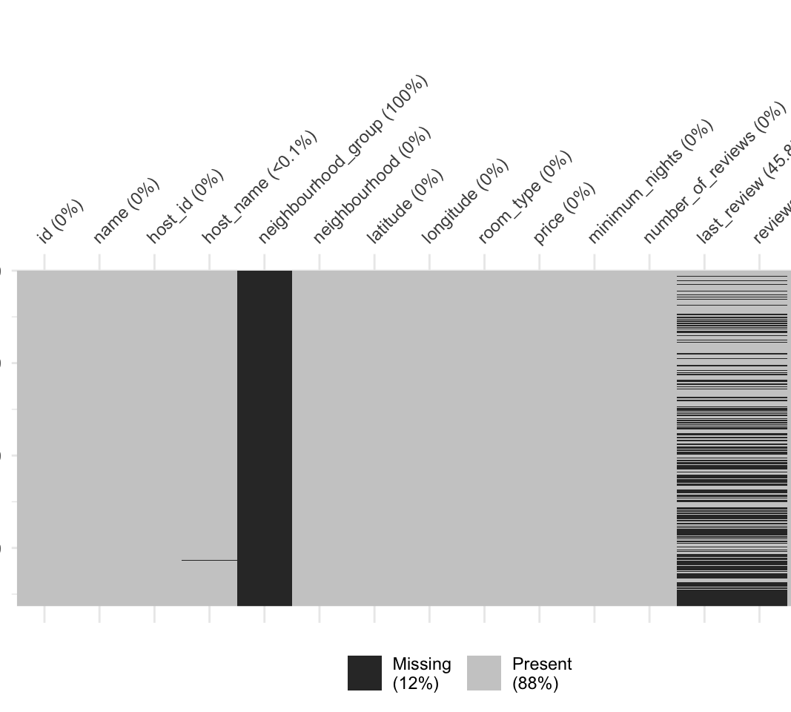
Data View/ Preparation
Use the package “DT” to display the data in HTML format
Because china has a different definition of the city. You will see many districts in the Shanghai City.

Slide 4
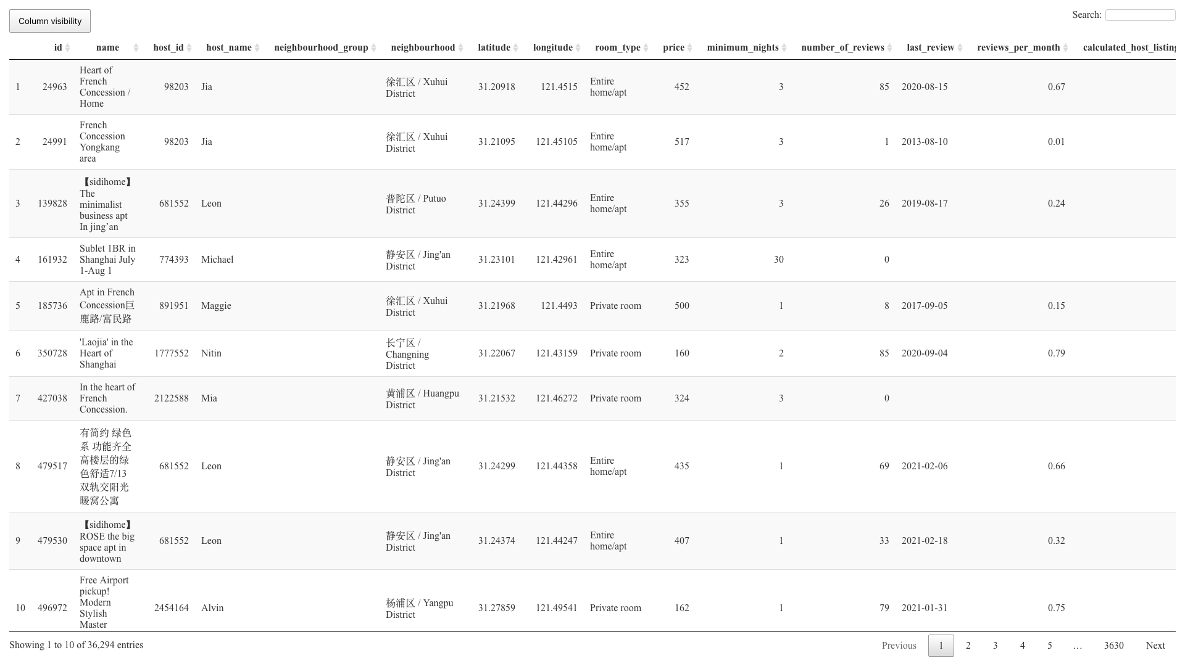

Slide 5

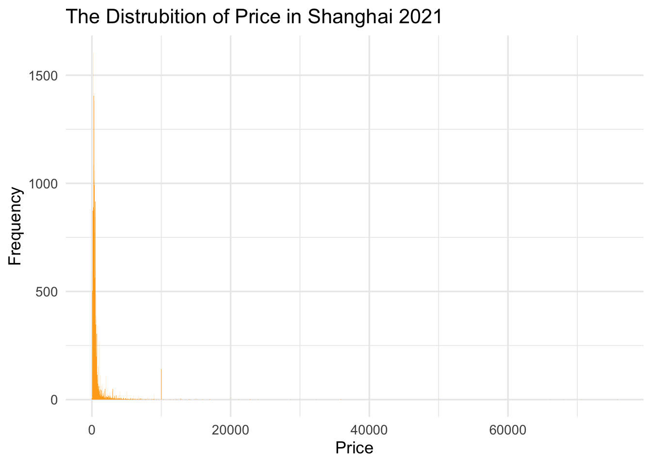
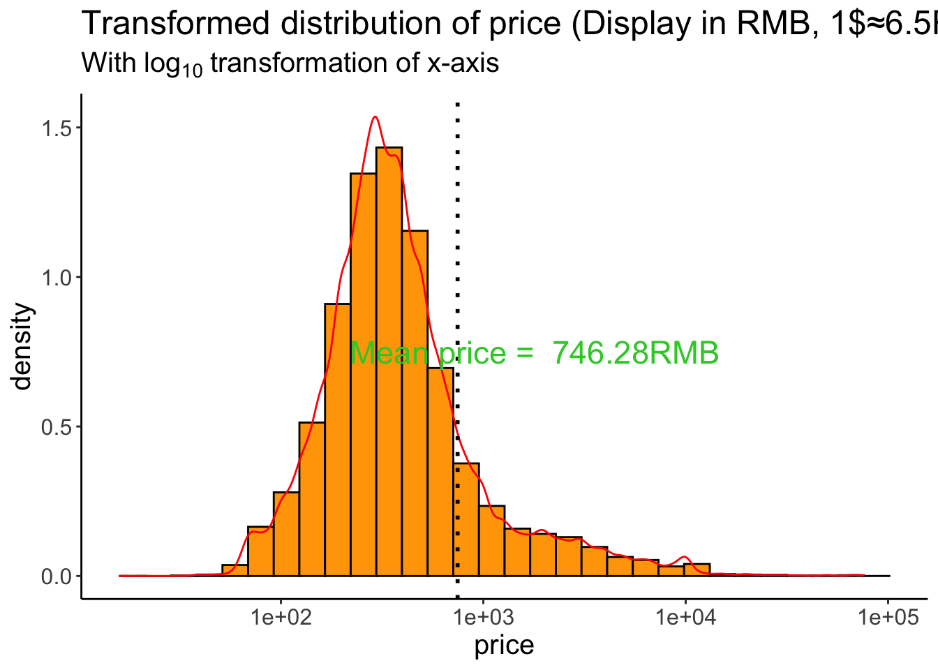
Price and Count/ Frequency

Slide 6
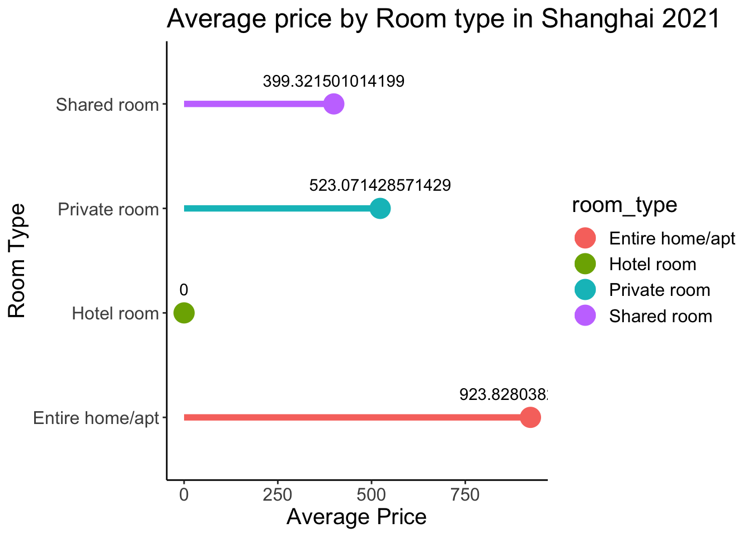
Average price by three room types

Slide 7
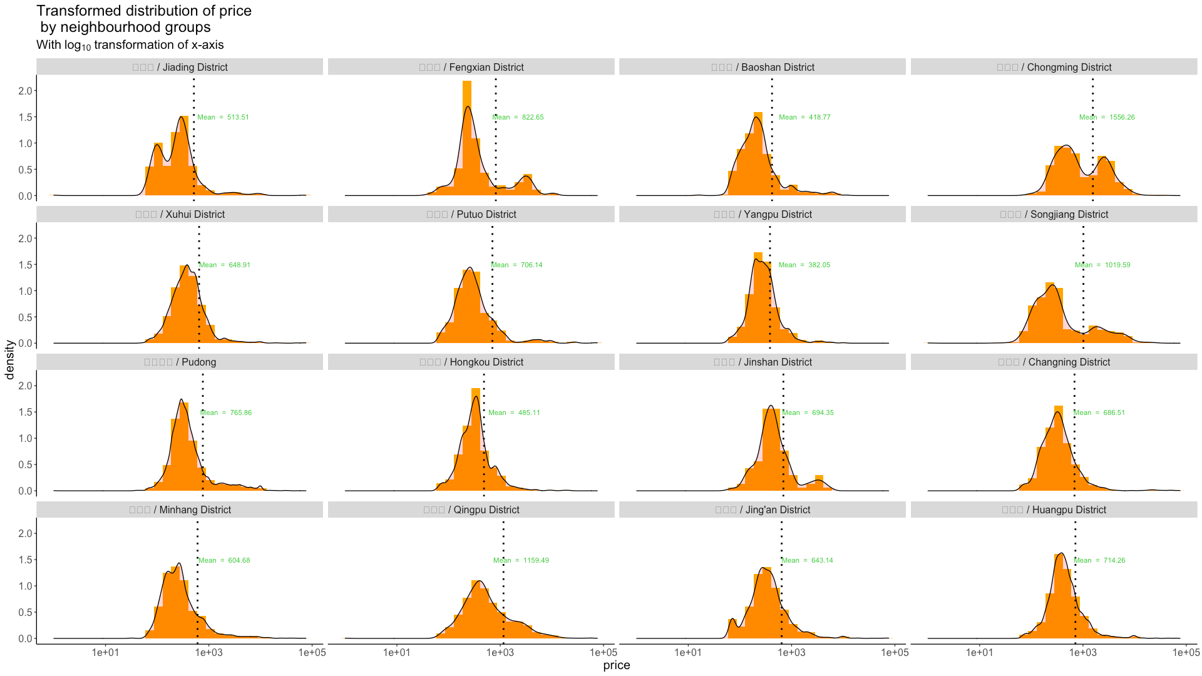
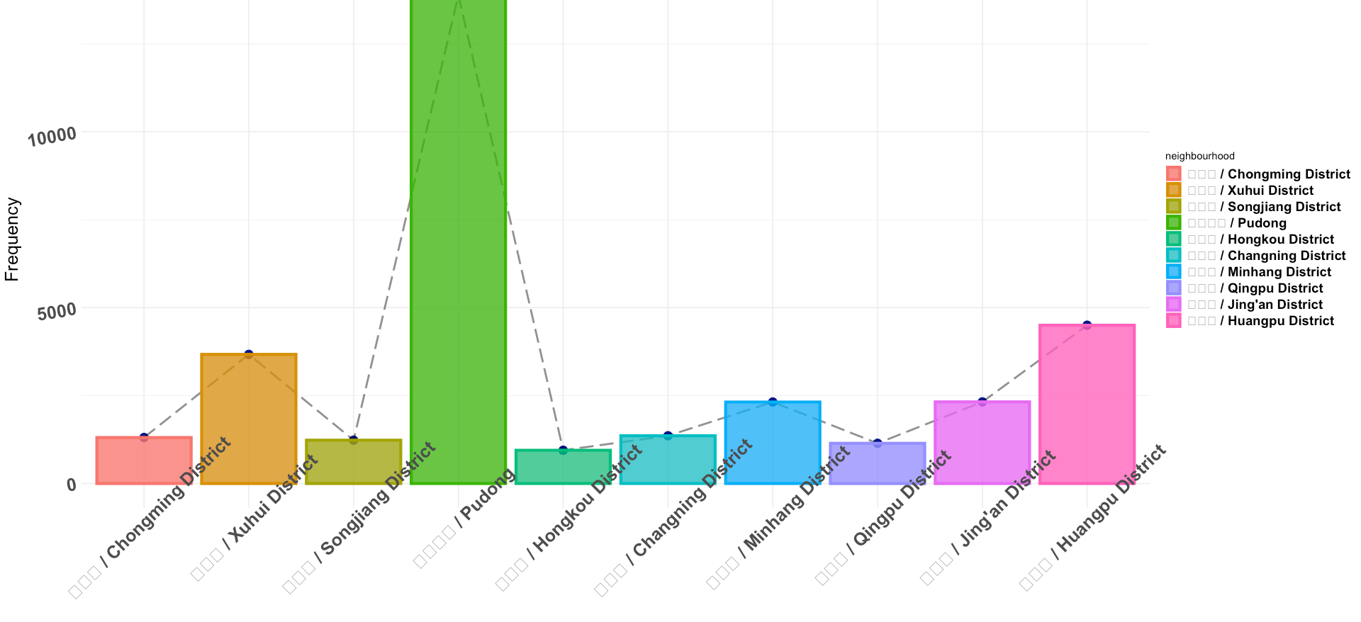
Songjiang District, Huangpu District, Xuhui District are the most frequent neighborhood

Slide 8
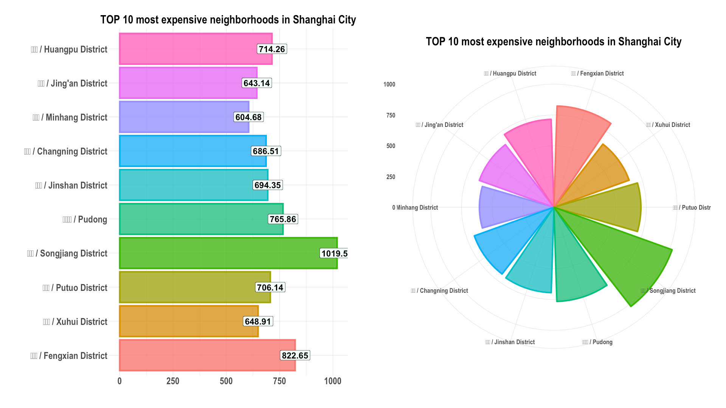

Slide 9
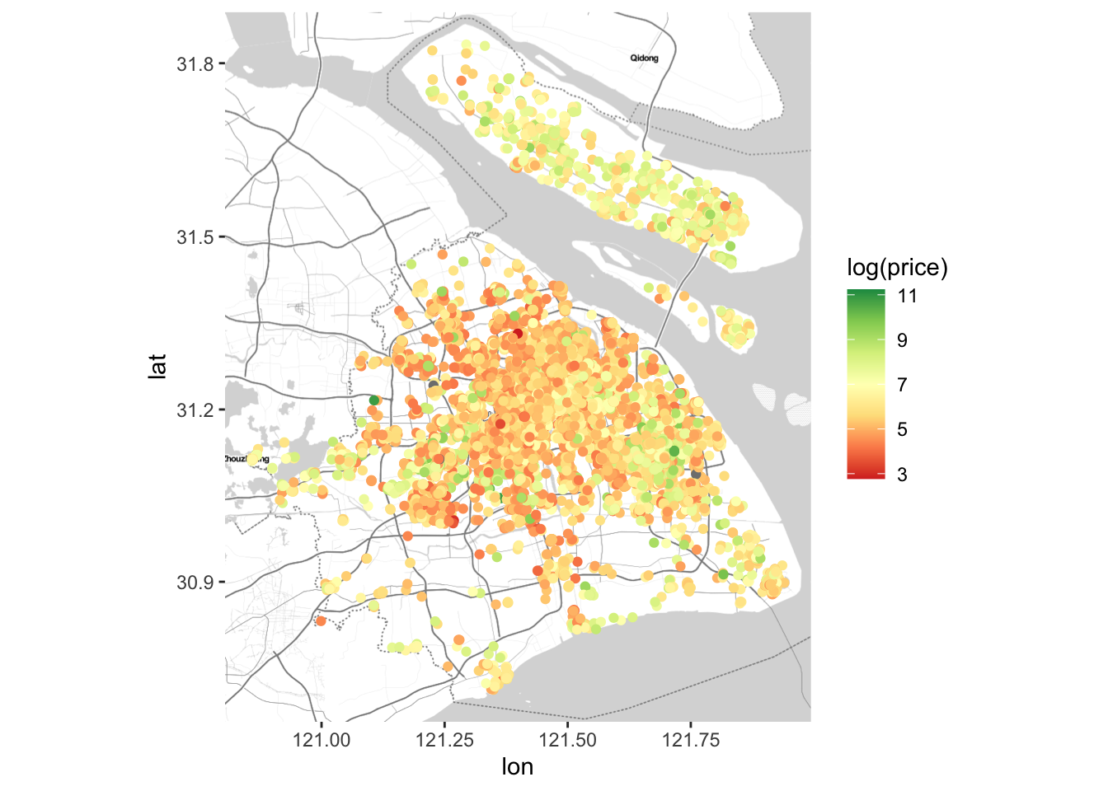
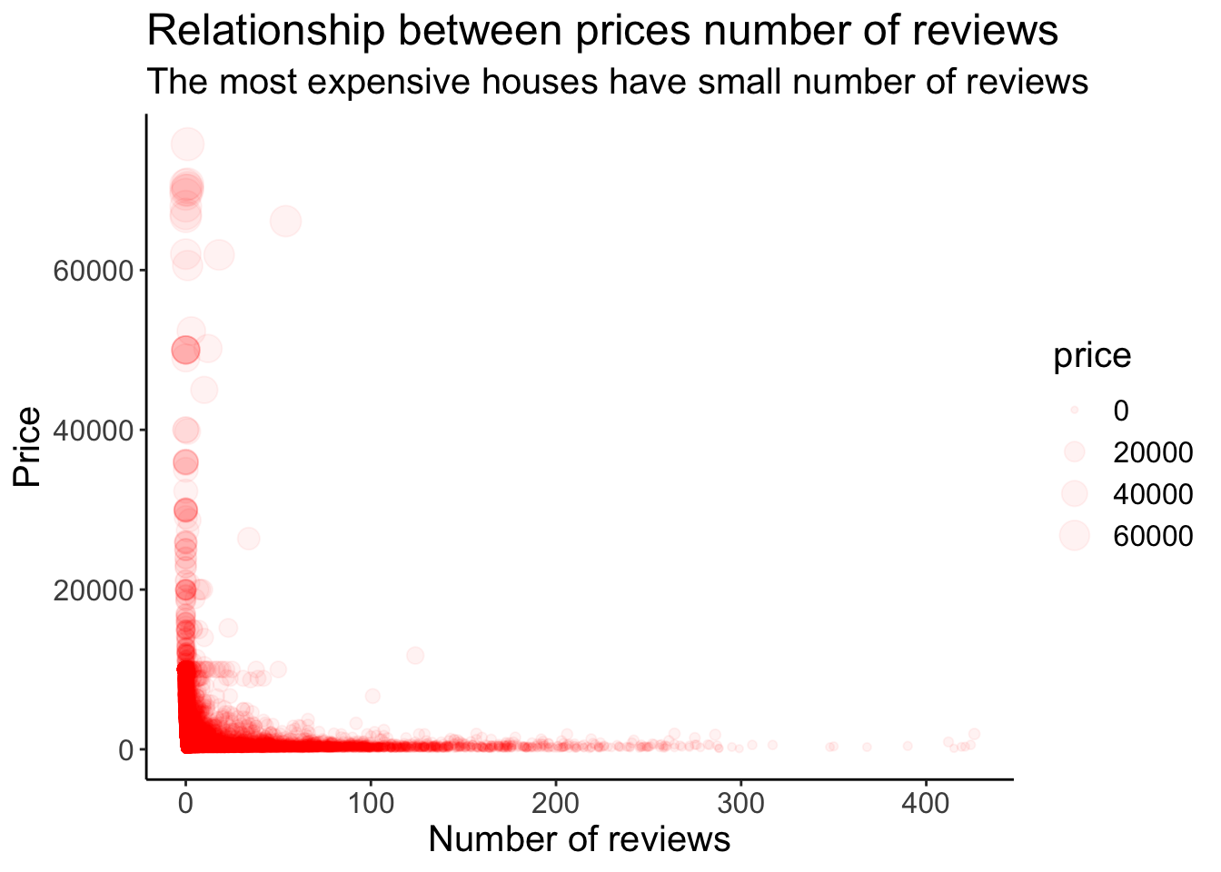
Location Map
Relationship between
prices and number of reviews

Slide 10
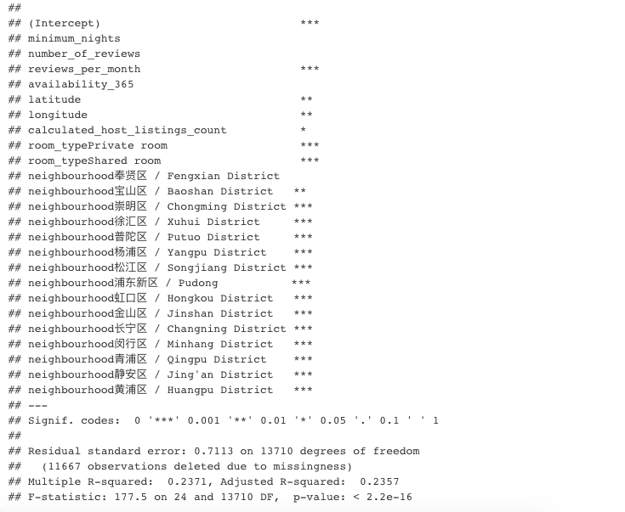
Linear Model R^2 is 0.2357
I just finalize this lm model, although it gives a not so good result.
It will not be used in price prediction!

Slide 11
THANK YOU
Qiren Wang
qiren.wang@rutgers.edu

